Slide 1
Online Food delivery System

Slide 2
Team Members
Sadiya tabassum
Aravindhan
Kowsika .s
Syam Kumar
Eruva Sowmya

Slide 3
Overview
* Introduction
*Objective
*System Requirements
*Proposed System
*Annotation
*Screenshots
*Conclusion

Slide 4
1.
Introduction

Slide 5
Introduction
*A website or app that allows customers to view the menu and place an order and an admin interface that enables the restaurant to receive and fulfill customer orders.
*Online Food Delivery System is mainly designed primarily function for use in the food delivery industry.
*This system will allow hotels and restaurants to increase online food ordering such type of business.
*The customers can be selected food menu items in a few minutes.
*In the modern food industries allows to quickly and easily delivery on customer place.
*Restaurant employees then use these orders through an easy to delivery on customers place and easy to find out navigate graphical interface for efficient processing

Slide 6
2. Objective

Slide 7
Objective
*To develop a system that will surely satisfies the customer service.
*To design a system able to accommodate huge amount of orders at a time.
*To evaluate its performance and acceptability in terms of security user-friendliness accuracy and reliability.
*To improve the communication between the client and the server and minimize the time of ordering .
*Main objectives of a restaurant to ensure the customer satisfaction.
*The manipulation of orders to the customers be so easy and quick y touching on the tablet and choosing the desired menu.
*The system will also automatically calculate the displays the final bill so the bills will ready to print without having any error because the information for that item is already inserted.

Slide 8
3.System Requirements

Slide 9
System Requirements
SOFTWARE REQUIREMENTS:-
*Operating System :64 bit(Windows 7/8/10)
*Eclipse(Hibernate ,Spring boot and HTML/CSS)
HARDWARE REQUIREMENTS:-
*RAM: Minimum 4GB
*ROM:256 GB

Slide 10
4.Proposed System

Slide 11
Proposed system
*There are two logins Admin and Customer.
*Only one Admin is allowed and any number of customers can register.
*Admin can add new products, edit and delete products.
*Customer can only view the product from Menu and add the products to the cart.
*Customers from the cart can total the products, place order and finally make payment.

Slide 12
5.Annotations

Slide 13
Annotations
@SpringBootApplication
Spring Boot is an open source Java-based framework used to create a micro Service. It is developed by Pivotal Team and is used to build stand-alone and production ready spring applications.
@Configuration
Indicates that a class declares one or more @Bean methods and may be processed by the Spring container to generate bean definitions and service requests for those beans at runtime.
@EnableWebSecurity
It is a marker annotation. It allows Spring to find (it's a @Configuration and, therefore, @Component ) and automatically apply the class to the global WebSecurity . If I don't annotate any of my class with @EnableWebSecurity still the application prompting for username and password.

Slide 14
@Autowired
provides more fine-grained control over where and how autowiring should be accomplished. The @Autowired annotation can be used to autowire bean on the setter method just like @Required annotation, constructor, a property or methods with arbitrary names and/or multiple arguments.
.
@Bean
@Bean annotation which is applied on a method to specify that it returns a bean to be managed by Spring context. Spring Bean annotation is usually declared in Configuration classes methods. This annotation is also a part of the spring core framework.
@PostMapping
Annotation for mapping HTTP POST requests onto specific handler methods. Specifically, @PostMapping is a composed annotation that acts as a shortcut for @RequestMapping(method = RequestMethod. POST) .

Slide 15
@Entity
The @Entity annotation specifies that the class is an entity and is mapped to a database table.
.
@Table
Ø@Table annotation allows you to specify the details of the table that will be used to persist the entity in the database. The @Table annotation provides four attributes, allowing you to override the name of the table, its catalog, and its schema, and enforce unique constraints on columns in the table.
@Controller
@Controller annotation indicates that a particular class serves the role of a controller. There is no need to extend any controller base class or reference the Servlet API.

Slide 16
@RequestMapping
The @RequestMapping annotation can be applied to class-level and/or method-level in a controller. The class-level annotation maps a specific request path or pattern onto a controller. You can then apply additional method-level annotations to make mappings more specific to handler methods.
.
@ModelAttriibute
It is an annotation that binds a method parameter or method return value to a named model attribute, and then exposes it to a web view.
@Service
@Service annotation is used with classes that provide some business functionalities. Spring context will auto detect these classes when annotation-based configuration and classpath scanning is used.

Slide 17
@Id
This annotation is used to specify the primary key generation strategy to use. i.e Instructs database to generate a value for this field automatically.
.
@GeneratedValue
Provides for the specification of generation strategies for the values of primary keys. The Generated Value annotation may be applied to a primary key property or field of an entity or mapped superclass in conjunction with the Id annotation.
@Transactional
@Transactional annotation is the metadata that specifies the semantics of the transactions on a method. We have two ways to rollback a transaction: declarative and programmatic.

Slide 18
@Service
@Service annotation is used with classes that provide some business functionalities. Spring context will auto detect these classes when annotation-based configuration and classpath scanning is used.
@Column
The Column annotation is used to specify the mapped column for a persistent property or field. If no Column annotation is specified, the default value will be applied.
@ManyToMany
A many-to-many association is made between two entities where one entity can be associated with multiple other instances of the other entity.
@JoinTable
The @JoinTable annotation is used to specify the table name via the name attribute, as well as the Foreign Key column that references the post table (e.g., join Columns ) and the Foreign Key column in the post_tag link table that references the Tag entity via the inverse Join Columns attribute

Slide 19
6.Screenshots

Slide 20
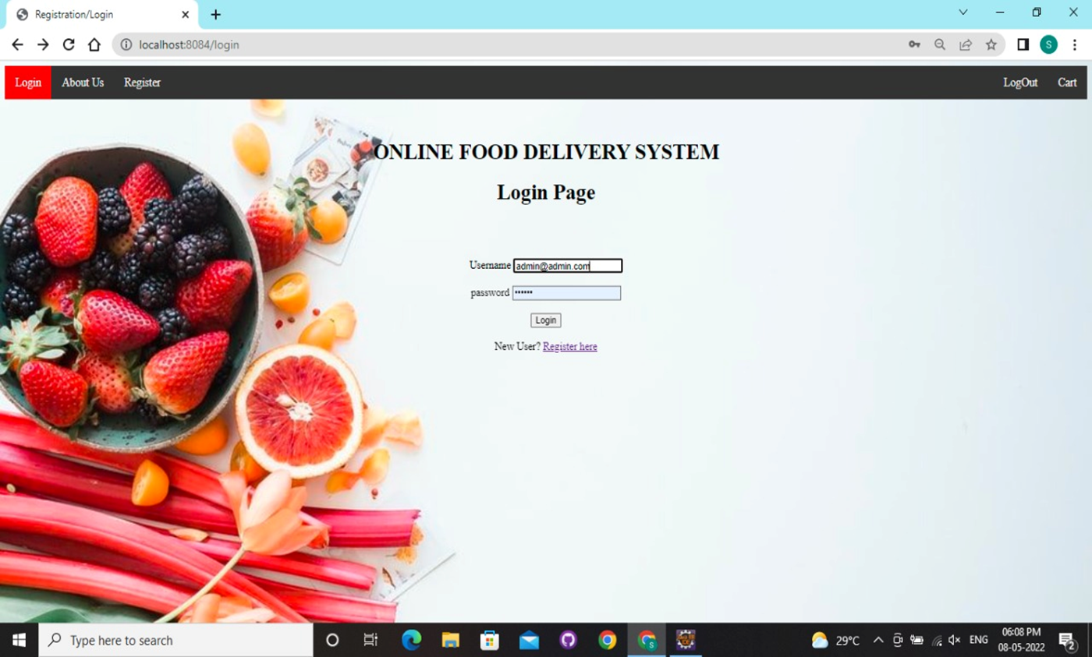
Login page

Slide 21
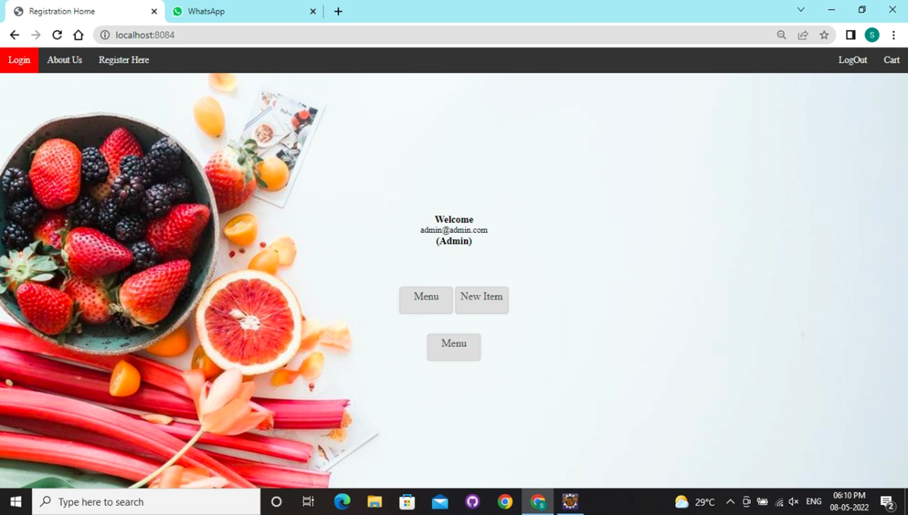
Admin page

Slide 22
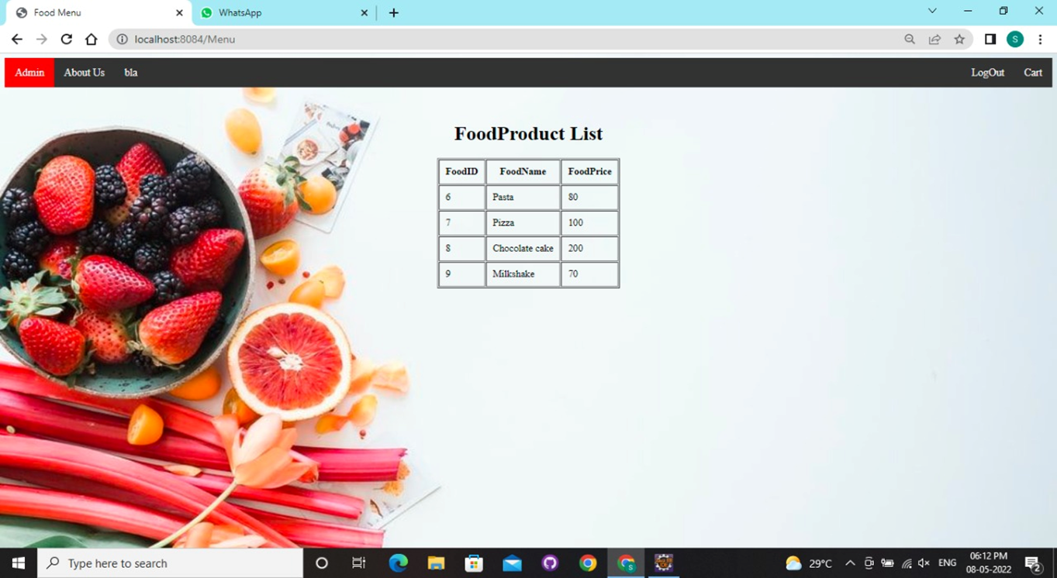
Food product list

Slide 23

Create new product

Slide 24

Menu page

Slide 25

Customer registraation

Slide 26
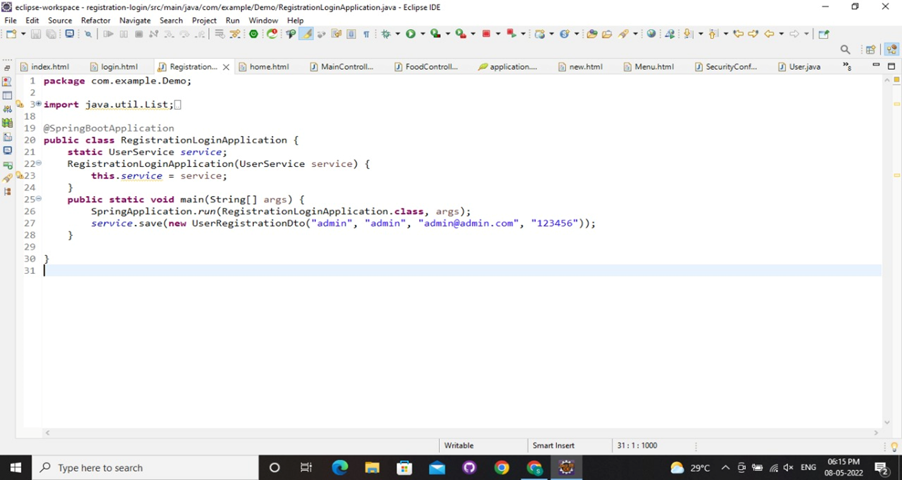
Registration login

Slide 27
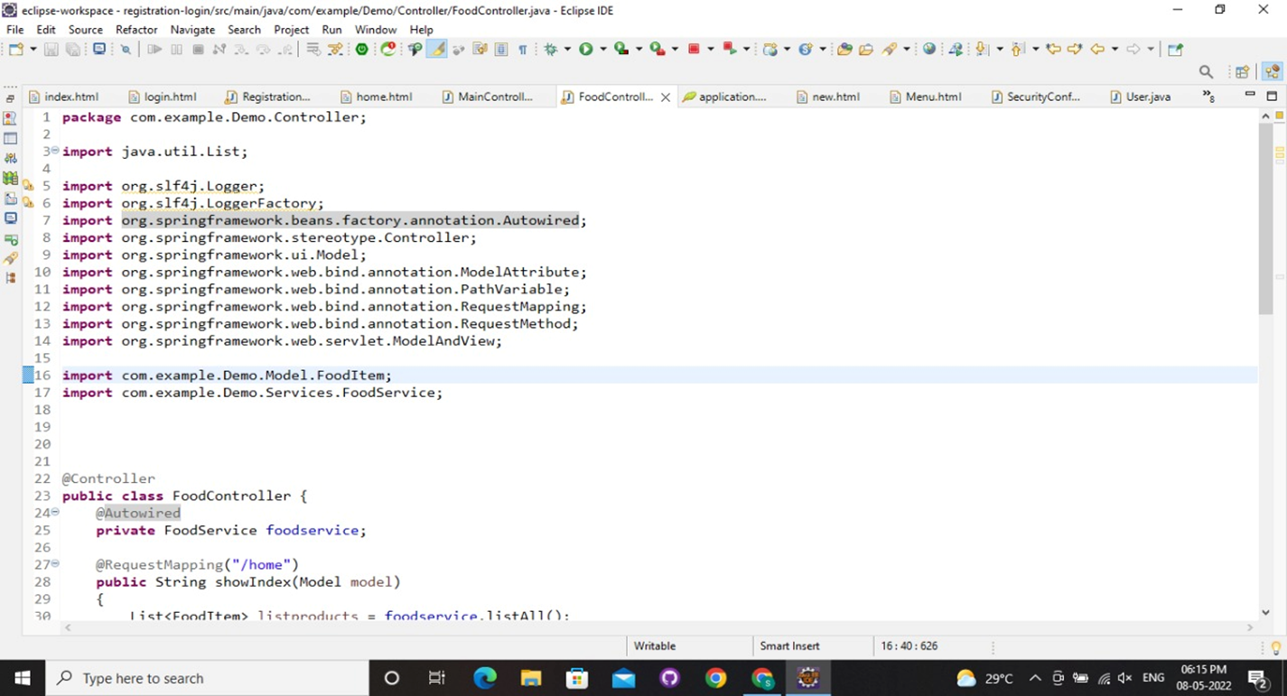
Food controller

Slide 28
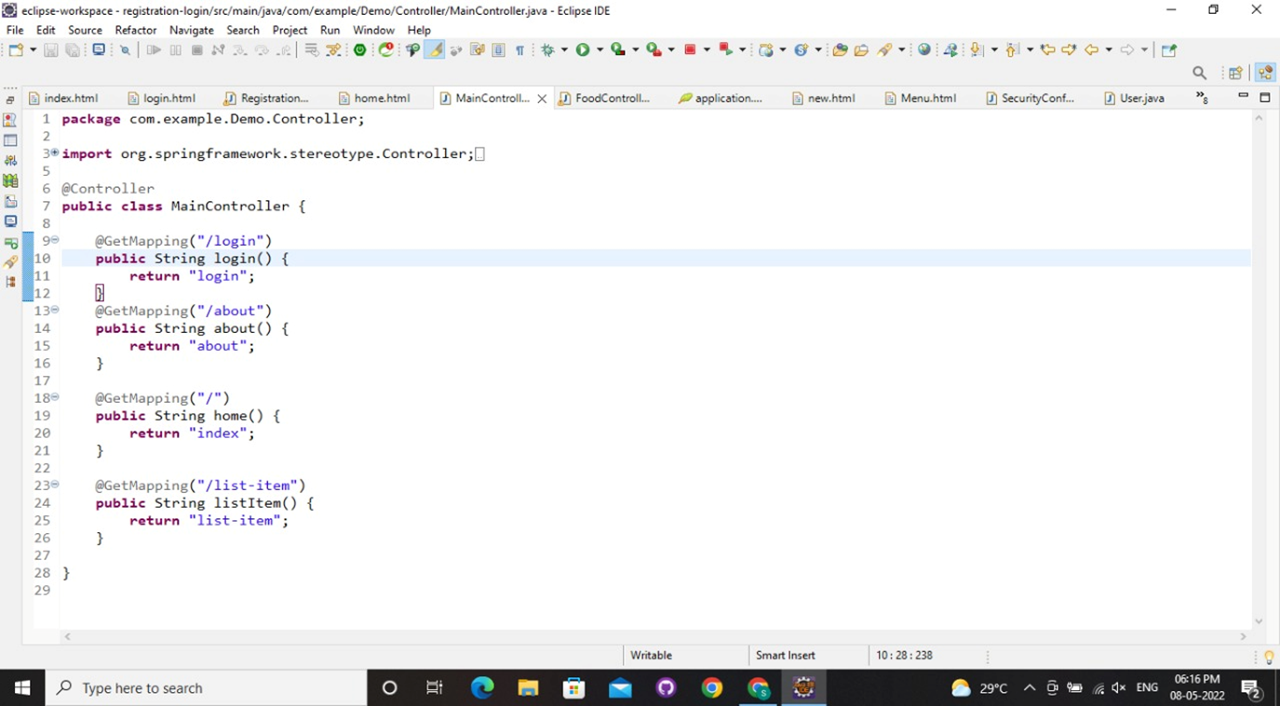
Main controller

Slide 29
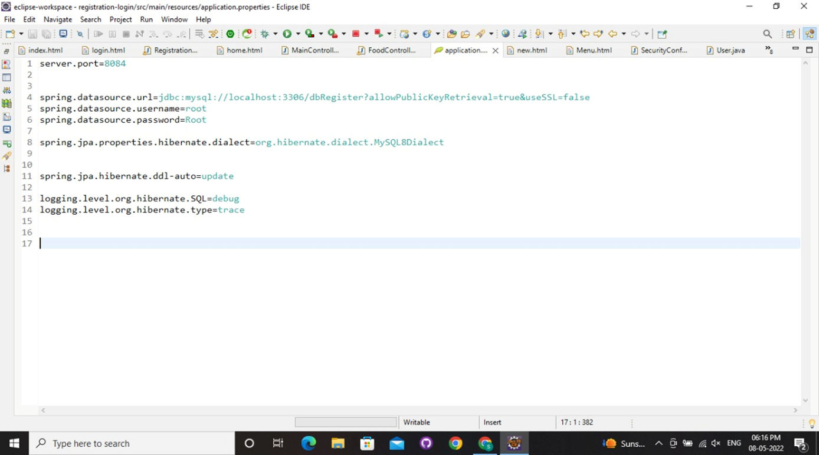
Application properties

Slide 30
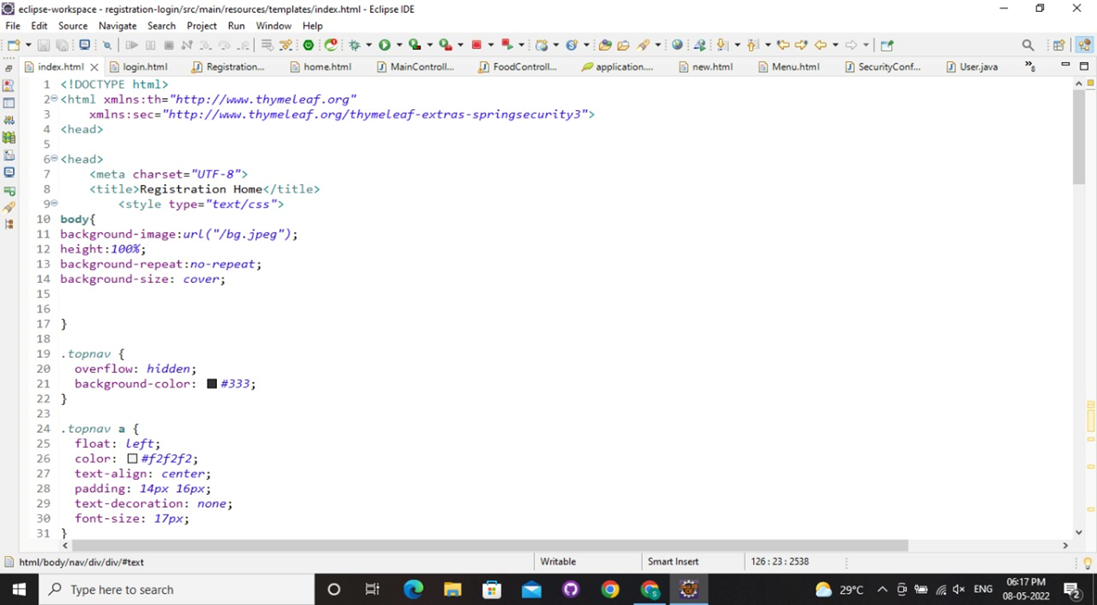
Index page

Slide 31
7.conclusion

Slide 32
Conclusion
*The Objective of this project is to build an application for Online Ordering Food and thus reducing manual work and making the traditional ordering system automated and faster.
*Overall we have created application in focus of future Food ordering system, this application will helpful to many people.

